Slide 1
Advanced Business
Communicating Design
With LoRa Communication Protocol

Slide 2




Existing Industrial IoT Networks
data
data
data
data
data
data
Using internet networks and Wi-Fi, coverage is local and expensive

Slide 3

Industrial IoT model
With LoRa protocol
data
data
data
data
data
data
Although the speed is limited, it is free and has wide coverage

Slide 4

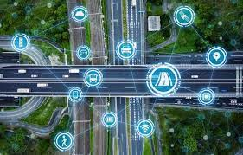

Characteristics of LoRa
Low Power
By ISM, The output does not exceed 10 to 25mW.
battery life is improved to an average of 9 to 10 years.
Wide Coverage
It allows long-distance connections up to 10 kilometers to allow effective Internet of Things.
Location Information Function
The location of the device can be tracked through the gateway.

Slide 5
Simulation of Facility
Sensor 1
Sensor 1
has detected defective!
Security...
Distinct?
Backhaul over:
WIFI
Cellular
Ethernet
Band of IBM: 915MHz
Sensor 2
Gateway
Network
Server
Sensor 3
“How does LoRa-based sensor send and receive data”

Slide 6
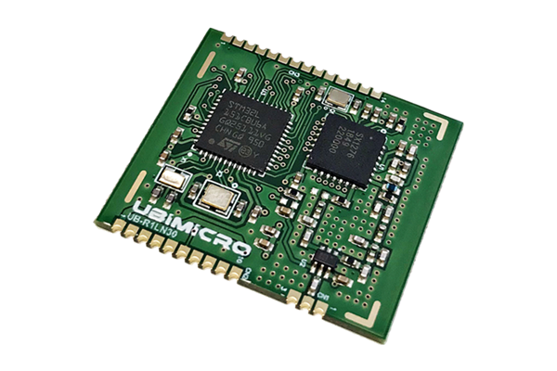
Microprocessor
UB-R1LN30
- Manufacturer: UBIMICRO - Frequency: 917.3 ~923.3MHz
Operating voltage: 3.3V
Bandwidth: 125KHz
Spread factor: 7~12
LoRa Module V3
- Extension Board -

Slide 7
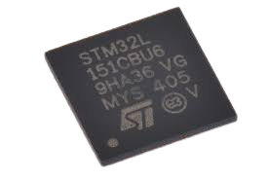
Microprocessor
STM32L151CBU6A
- Manufacturer: STMicroelectronics - The design of Low-Power applications
Up to two I2C and SPI and three USARTs
DMIPS: 5~33.3 DMIPs
MCU of LoRa sensor

Slide 8

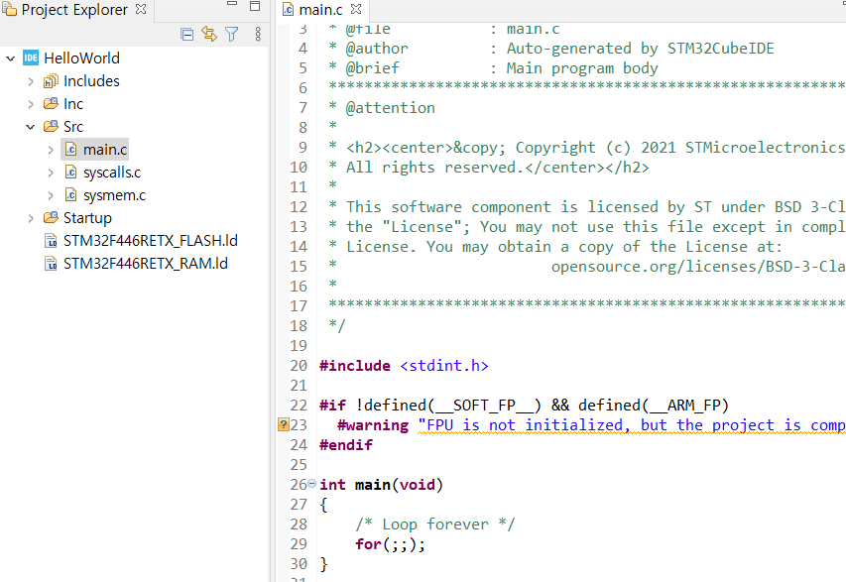
Integrated Development Environment
STM32CubeIDE
- Targeted Language: C, C++ - Based Environment: Eclipse
Debugger: GDB
Integrated Development Environment
interior appearance

Slide 9

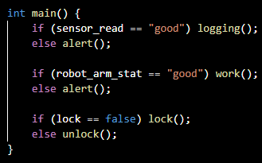
Current Construction Status
GCC
Library
Linker
Firmware.bin
Firmware.obj
Firmware.bin
Firmware.c

Slide 10


Current Construction Status
LPWA_Router
LPWA_Server
(Web Server)
LPWA_Router
Firmware.bin
Firmware.bin
Firmware.bin
Firmware.bin
LPWA_Router

Slide 11
Current Construction Status
LoRa_mng
LoRa_mng
LPWA_Router
Firmware.bin
Firmware.bin
Firmware.bin
LoRa_mng

Slide 12
Details of Future System Structure

Slide 13
Details of Future System Structure
(without Blockchain)
data
data
data
data
data
data
data
data

Slide 14
Details of Future System Structure
(without Blockchain)
???
???
data
data

Slide 15
Details of Future System Structure
(with Blockchain)
TX
TX
TX
Hash
123456789
Hash
ZZZXXXCCC
Hash
999888777
Hash
999888777
Hash
ABC123DEF
Hash
123456789
Hash
ZZZXXXCCC
Hash
ABC123DEF

